Slide 1
DataXplorers, Challenge 2
Approach 1: Hue Analysis

Slide 2
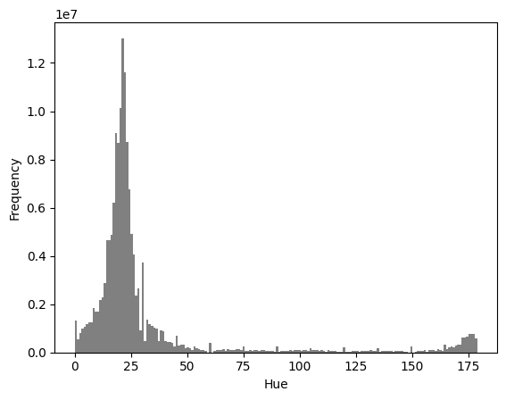
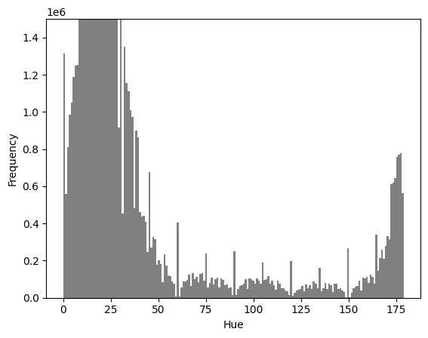
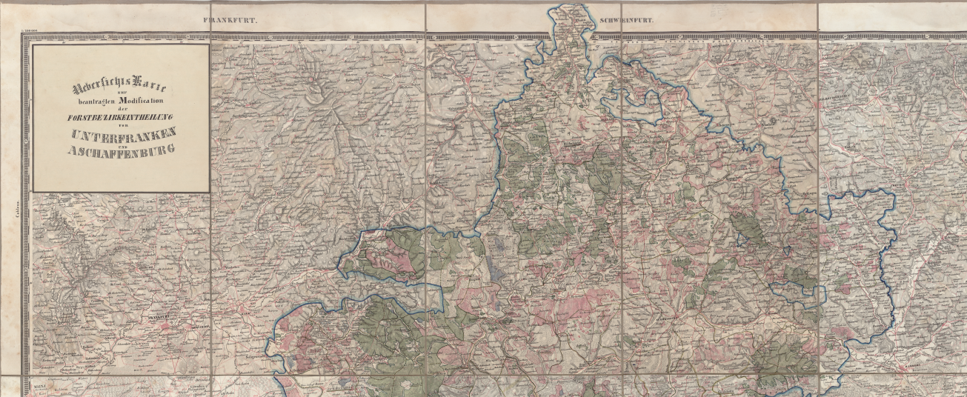
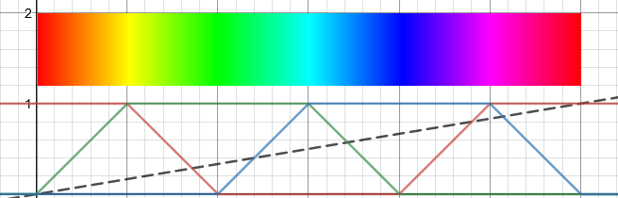
Hue Analysis
Calculate histogram for Hue values
Find relevant peaks
Count peaks
if nb(peaks) > 1: Colorized image (assumes that darks don’t resolve to a relevant peak)

Slide 3
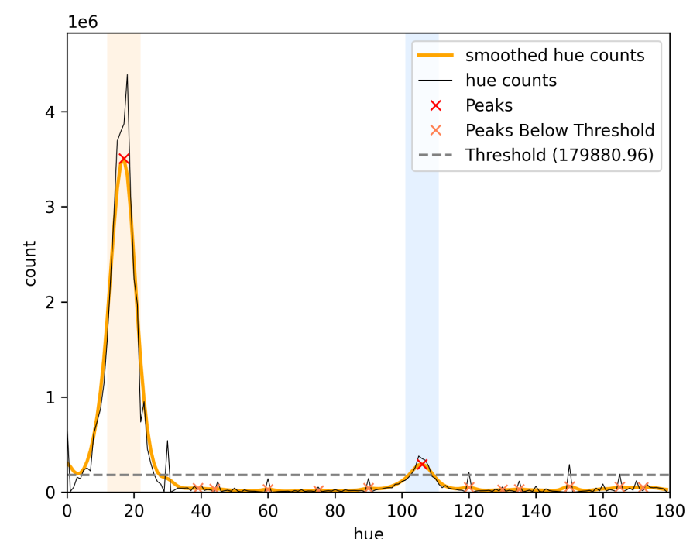
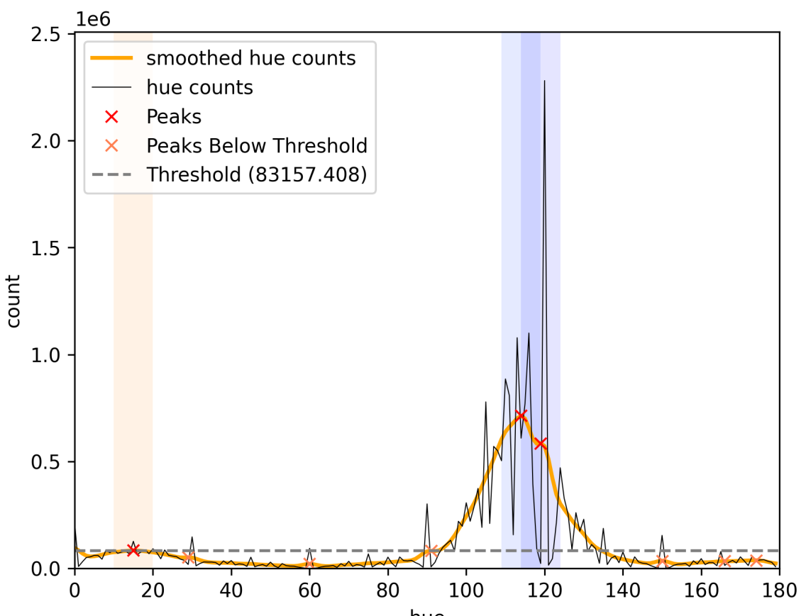
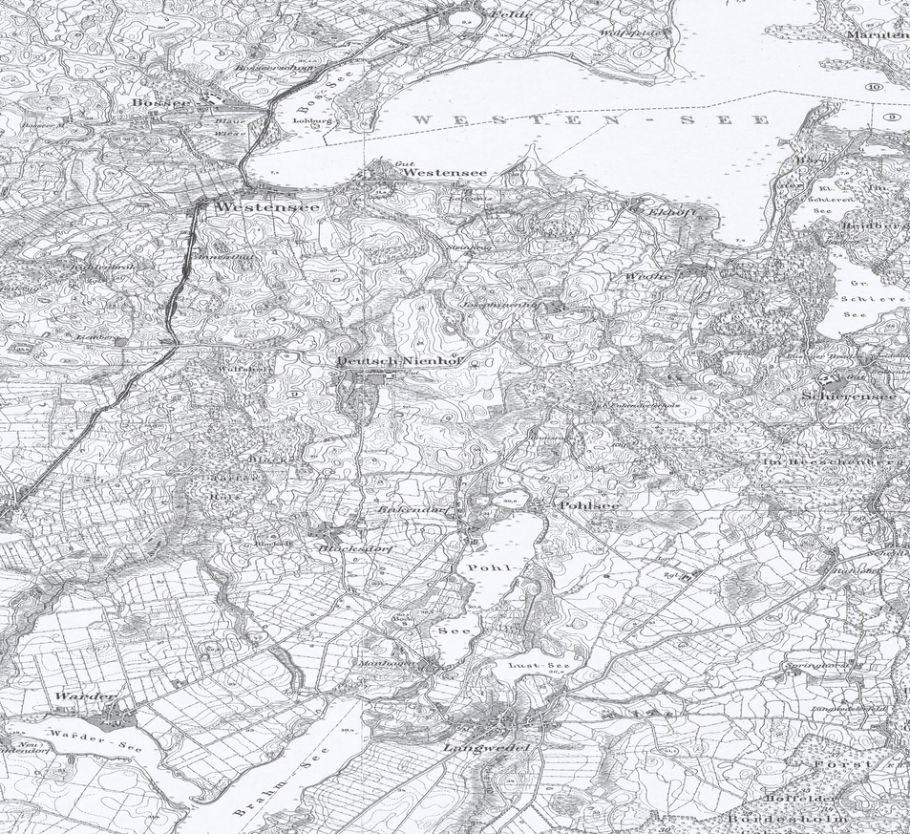
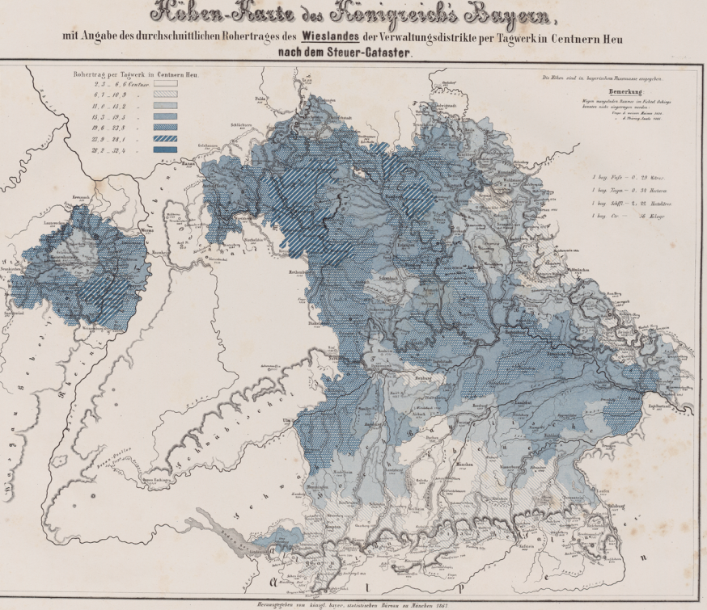
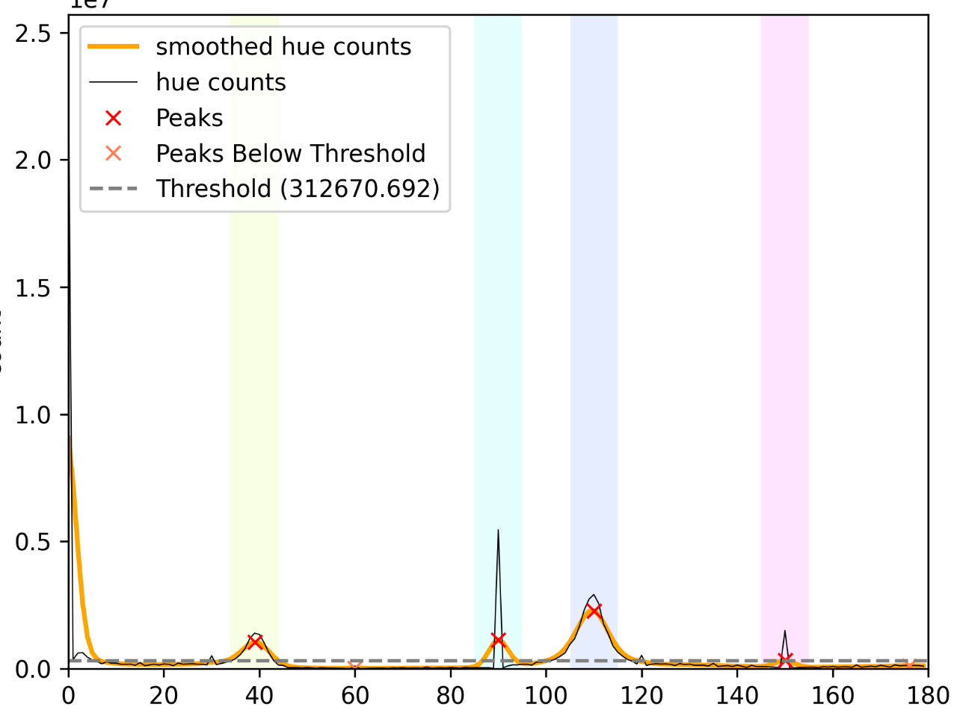
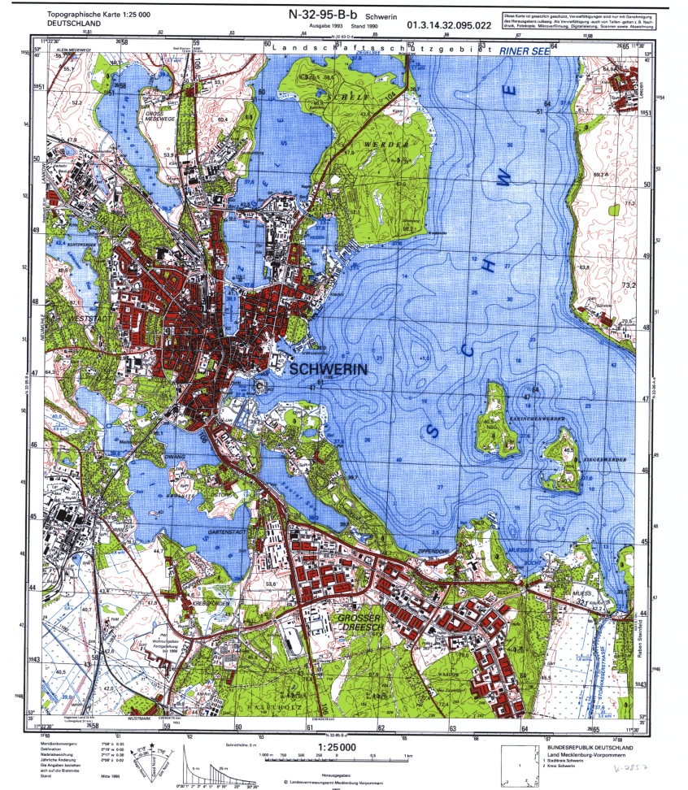
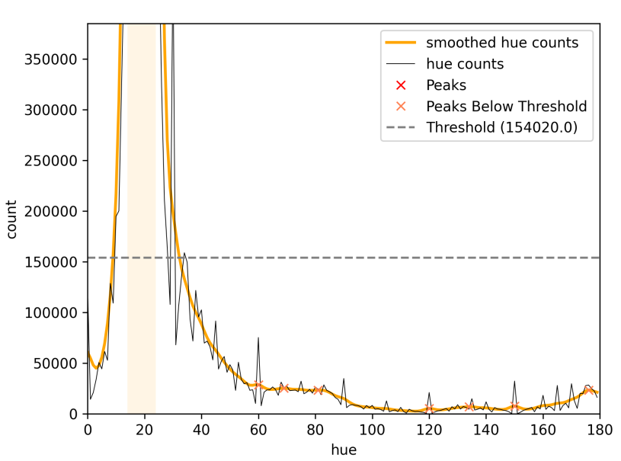
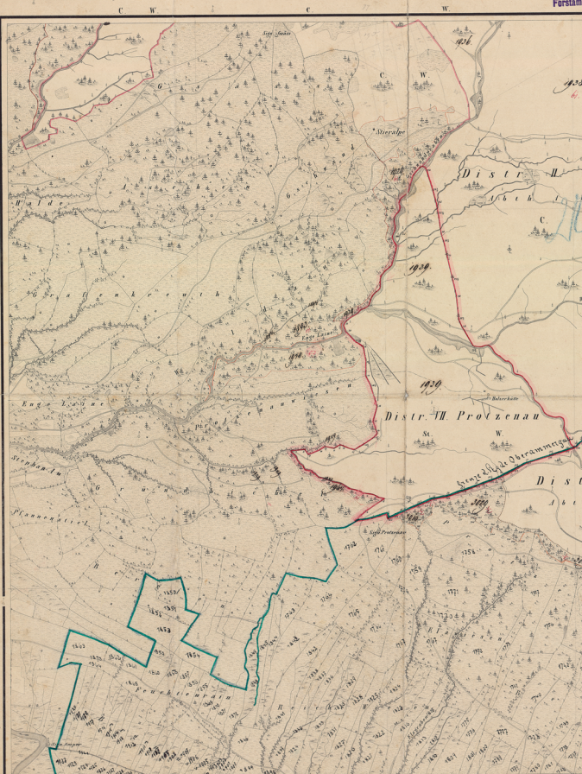
Smoothing, multiple peaks
In background
Works as expected
Circularity problem, peak exactly at
full period
Low number of colored pixels

Slide 4
Results:
true true: 32
false false: 15
true false: 12
false true: 1
Problems:
circularity
smoothing (unequal distribution of perceived colors)
threshold (problematic if number of colorized pixels is low)
Approach 2: CIElab Analysis

Slide 5
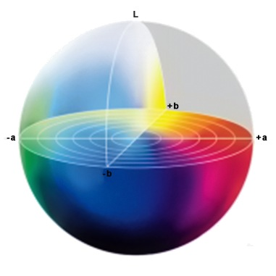
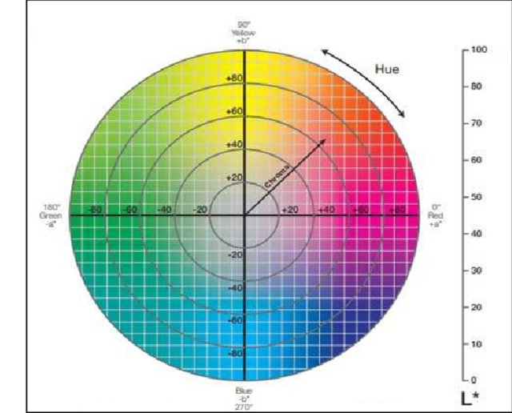
CIELAB (Lab) color space
Main point: more equally distribution of colors

Slide 6
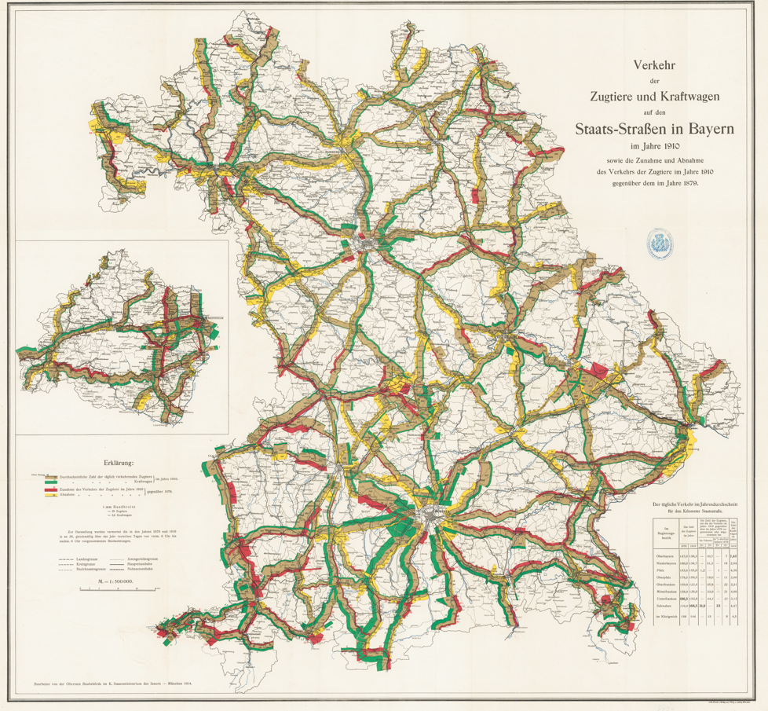
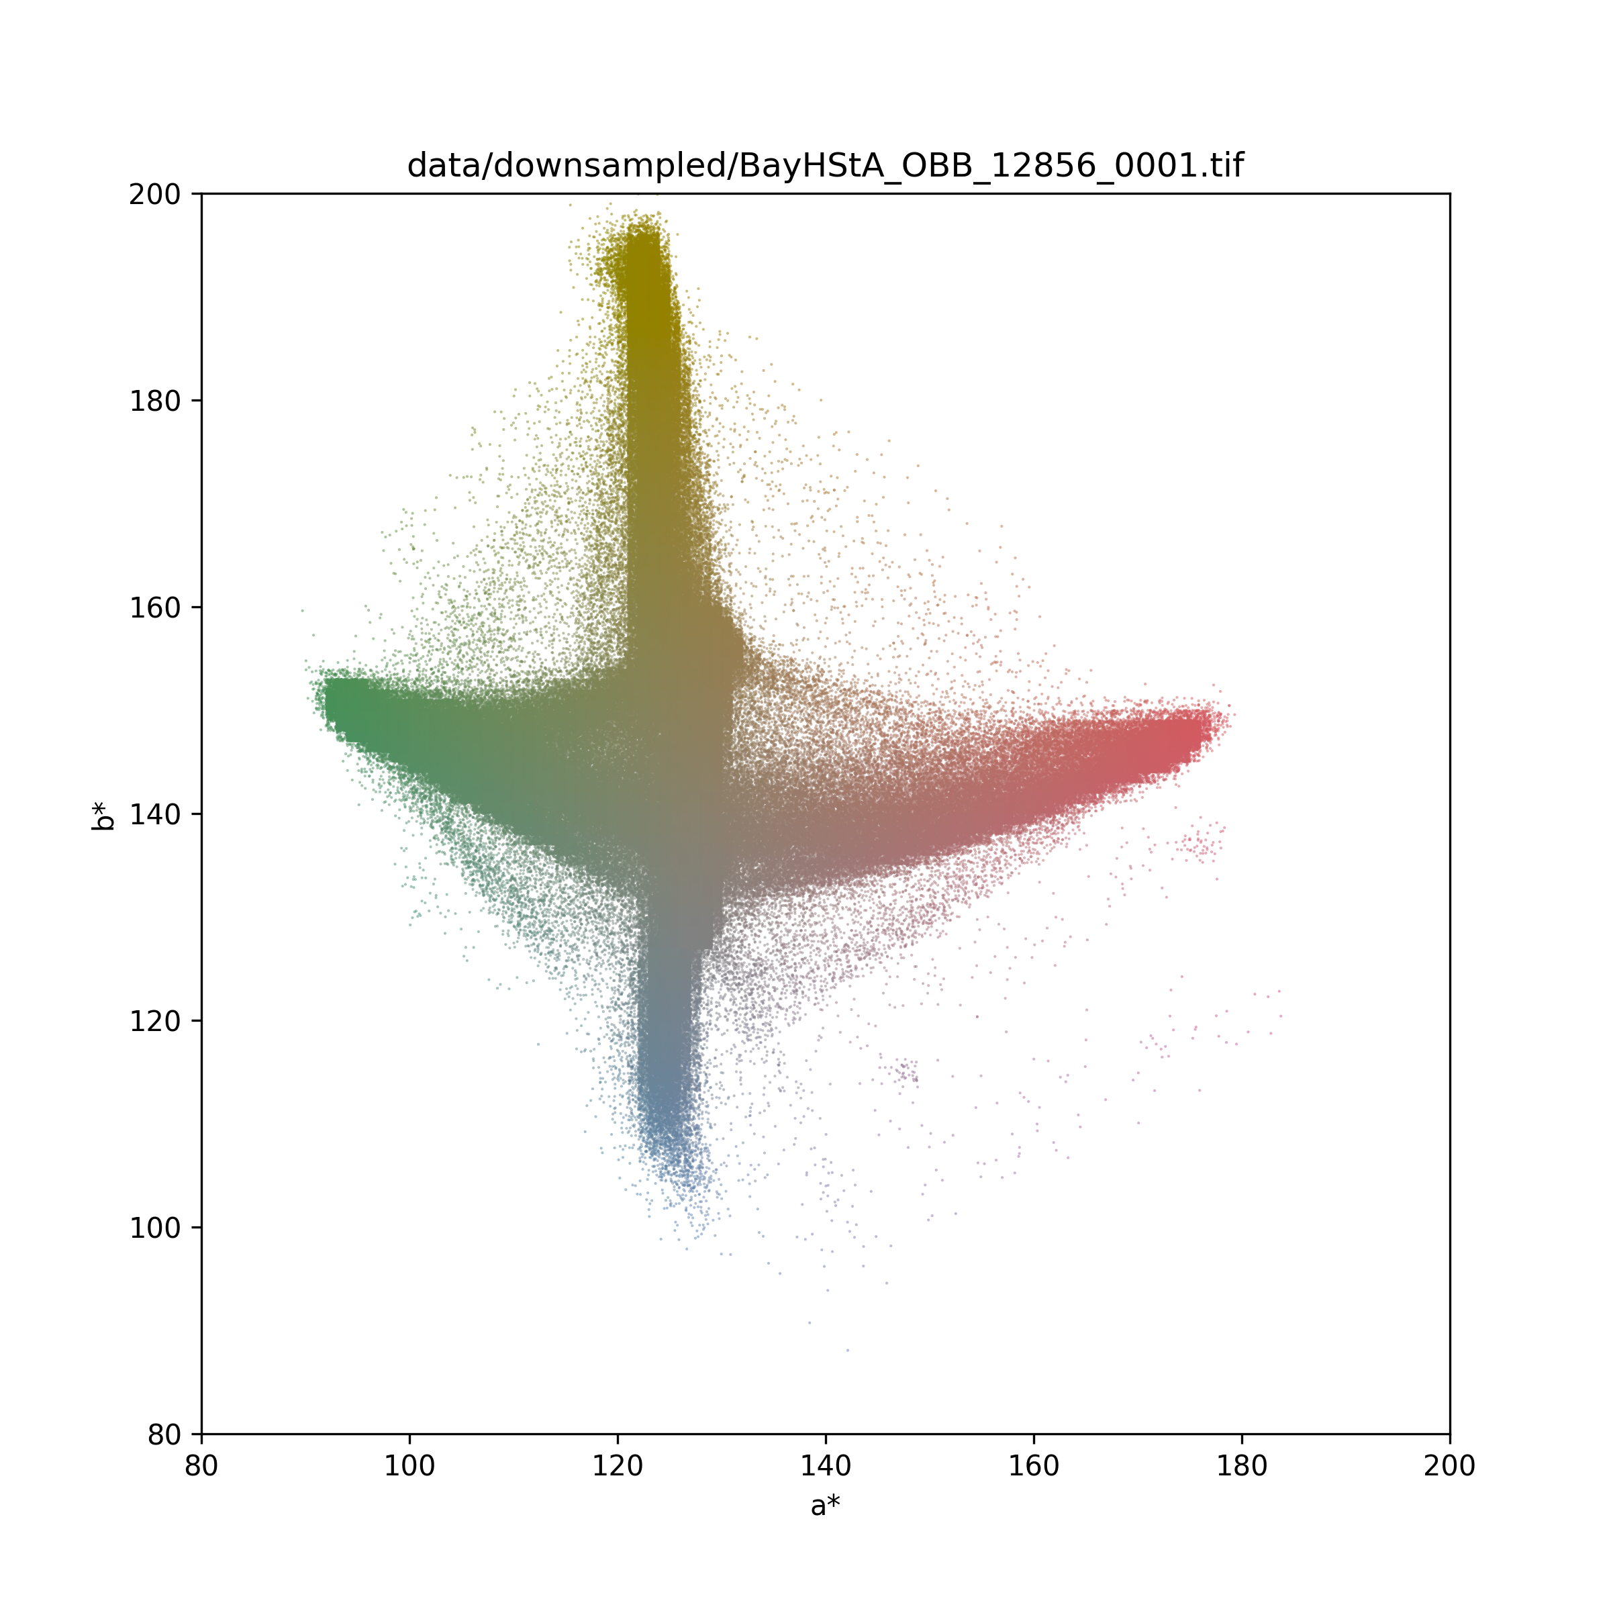
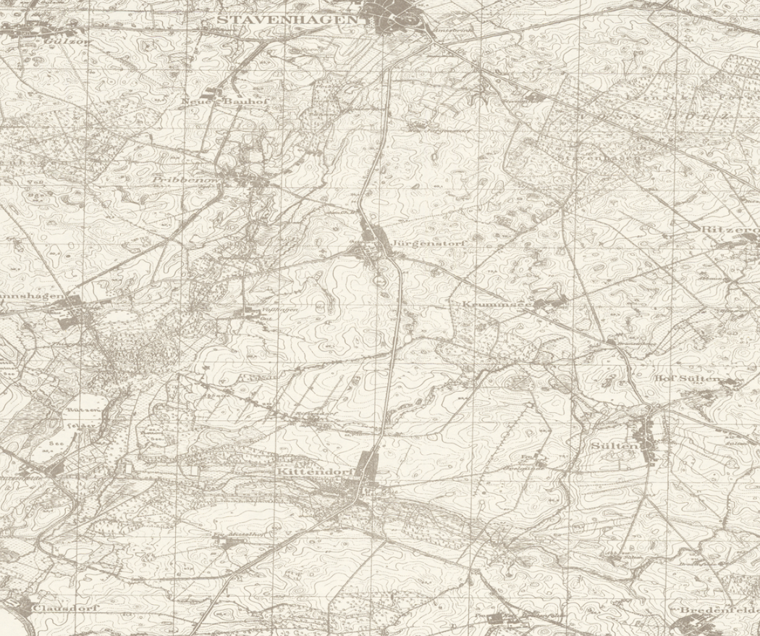
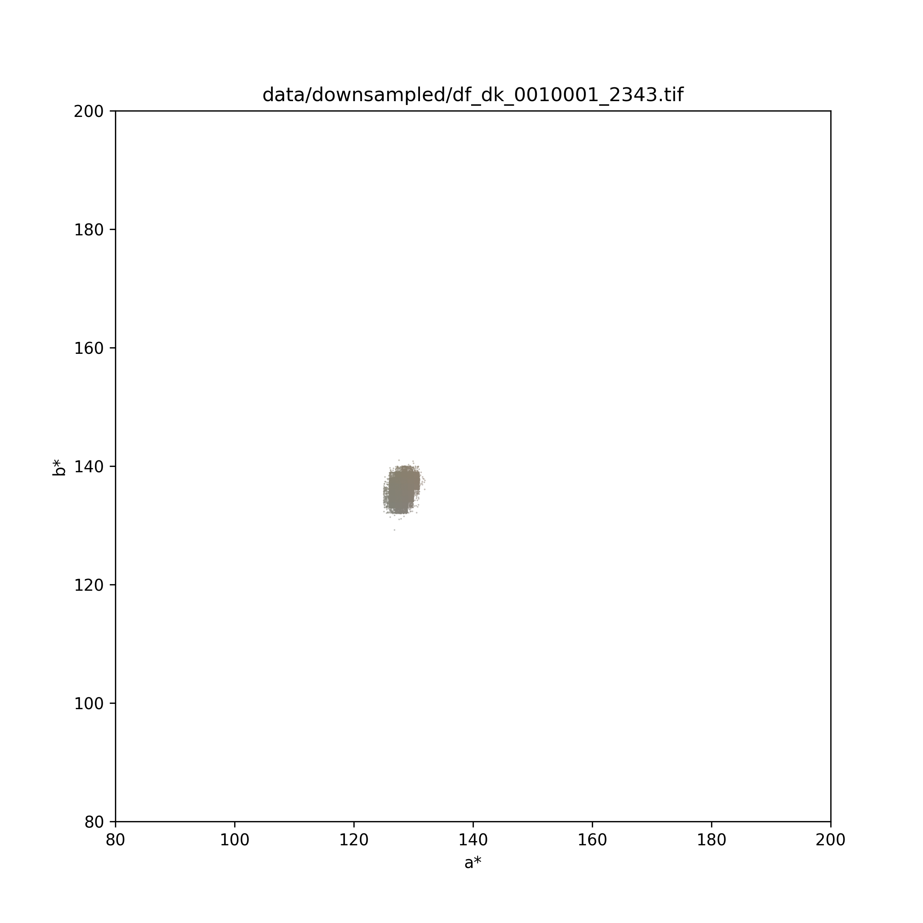
Graphics:
Convert image to Lab
Plot in a*-b* plane
Colorize with medium luminance
Add jitter and transparency

Slide 7
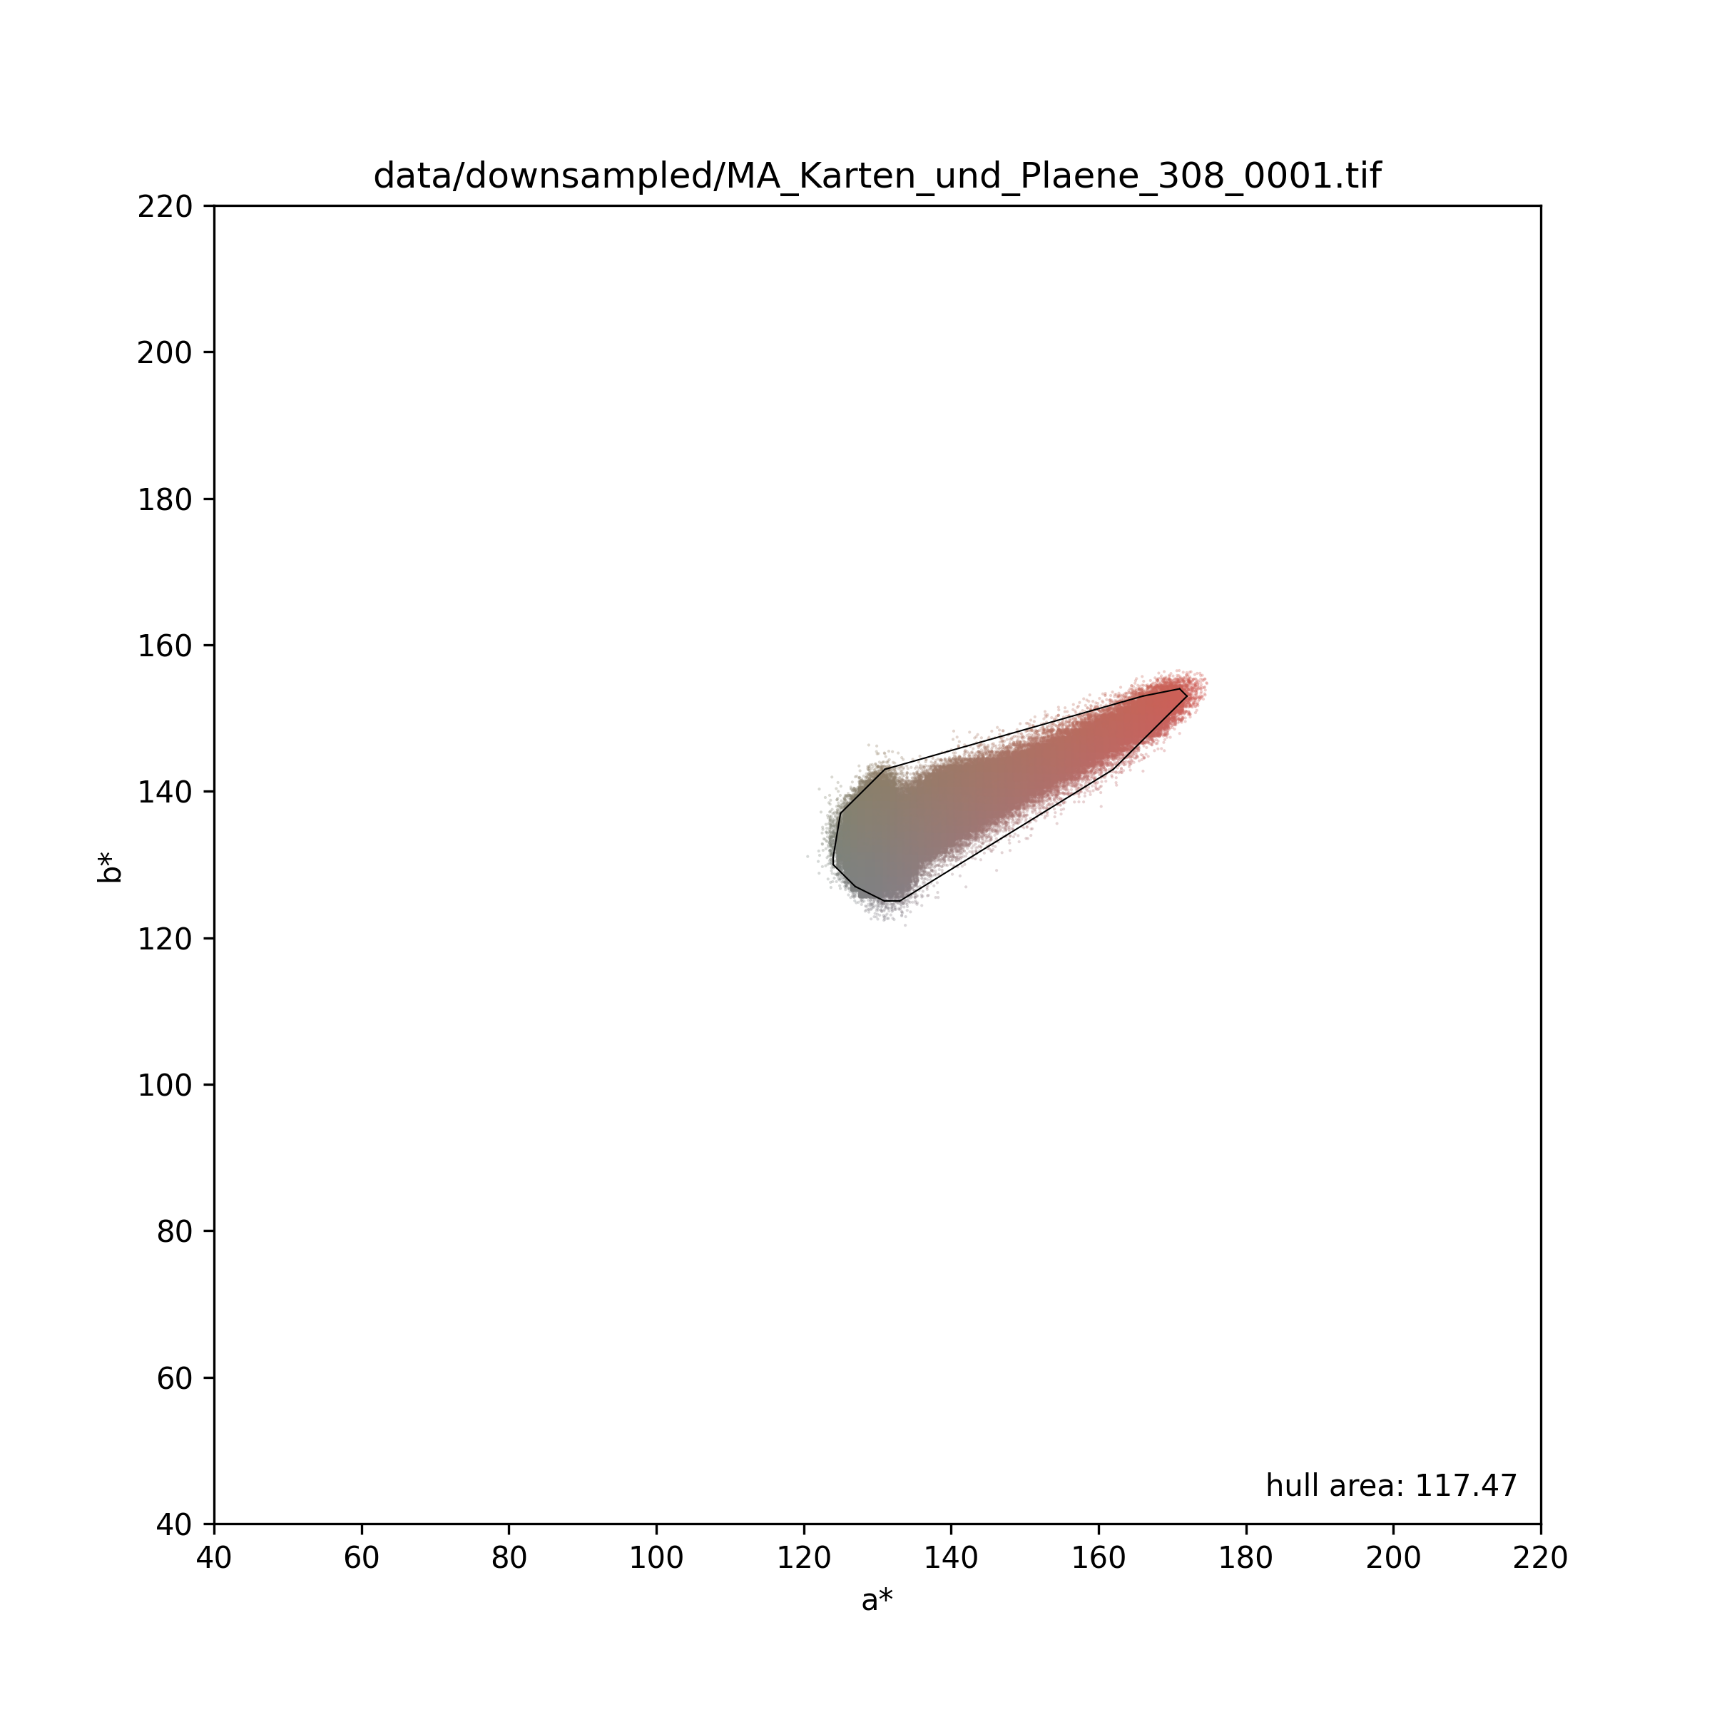
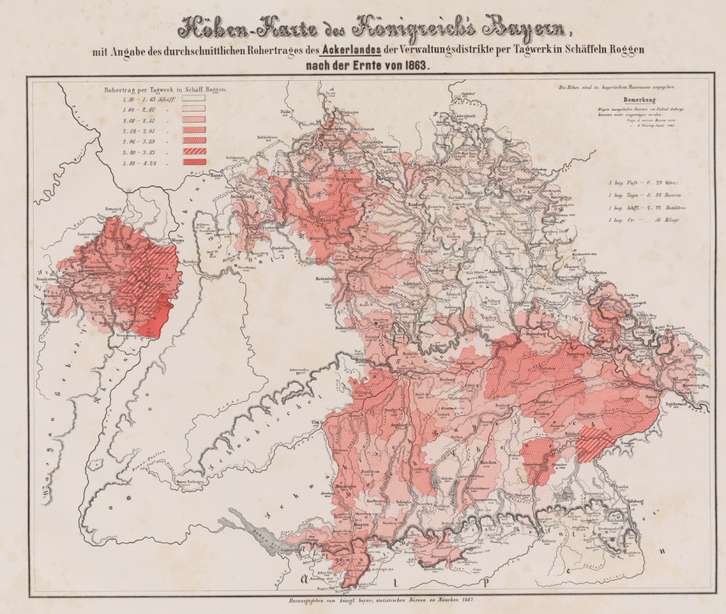
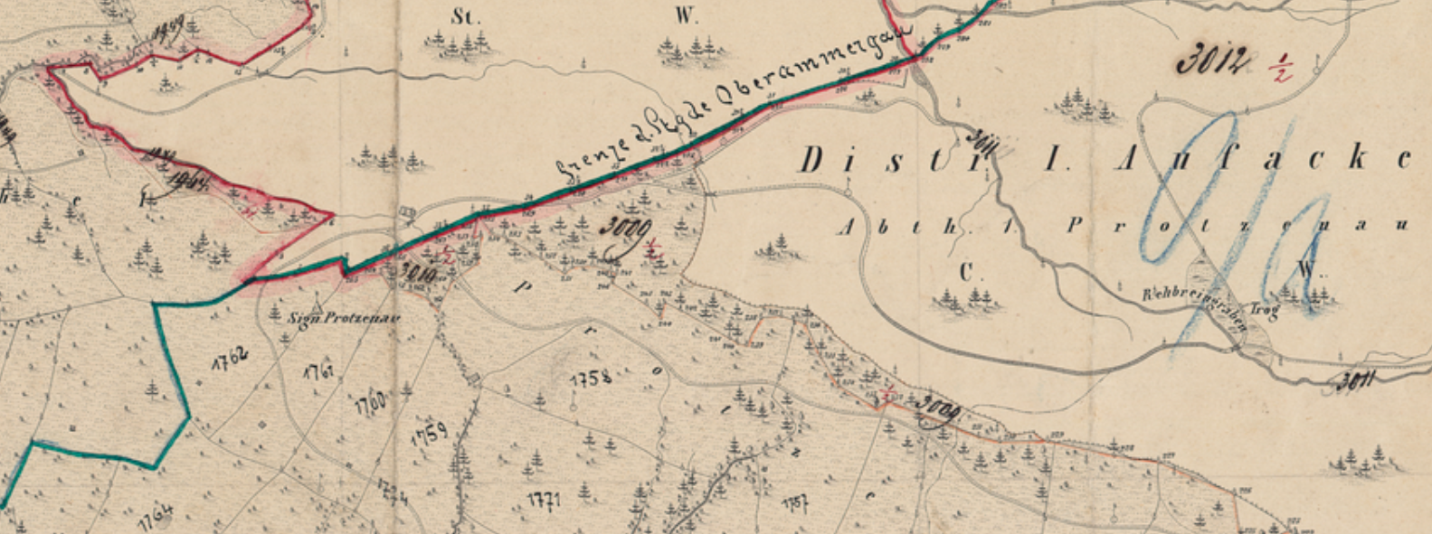
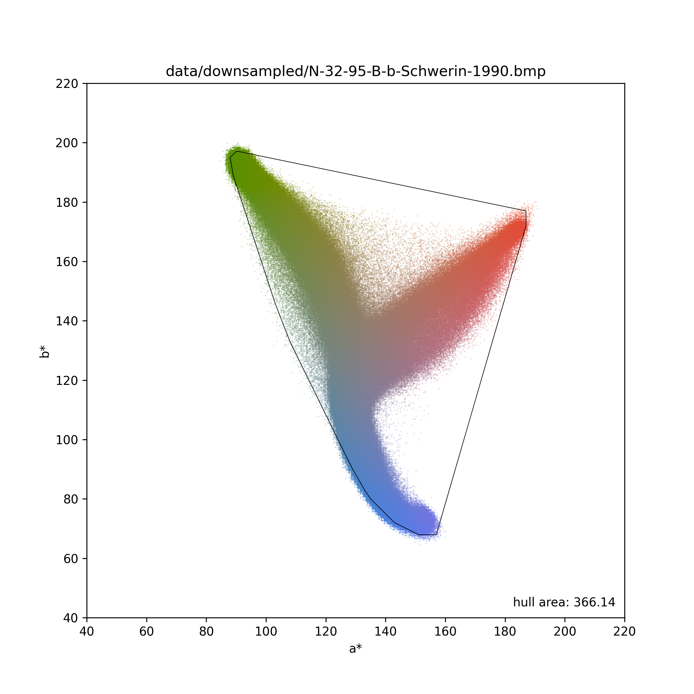
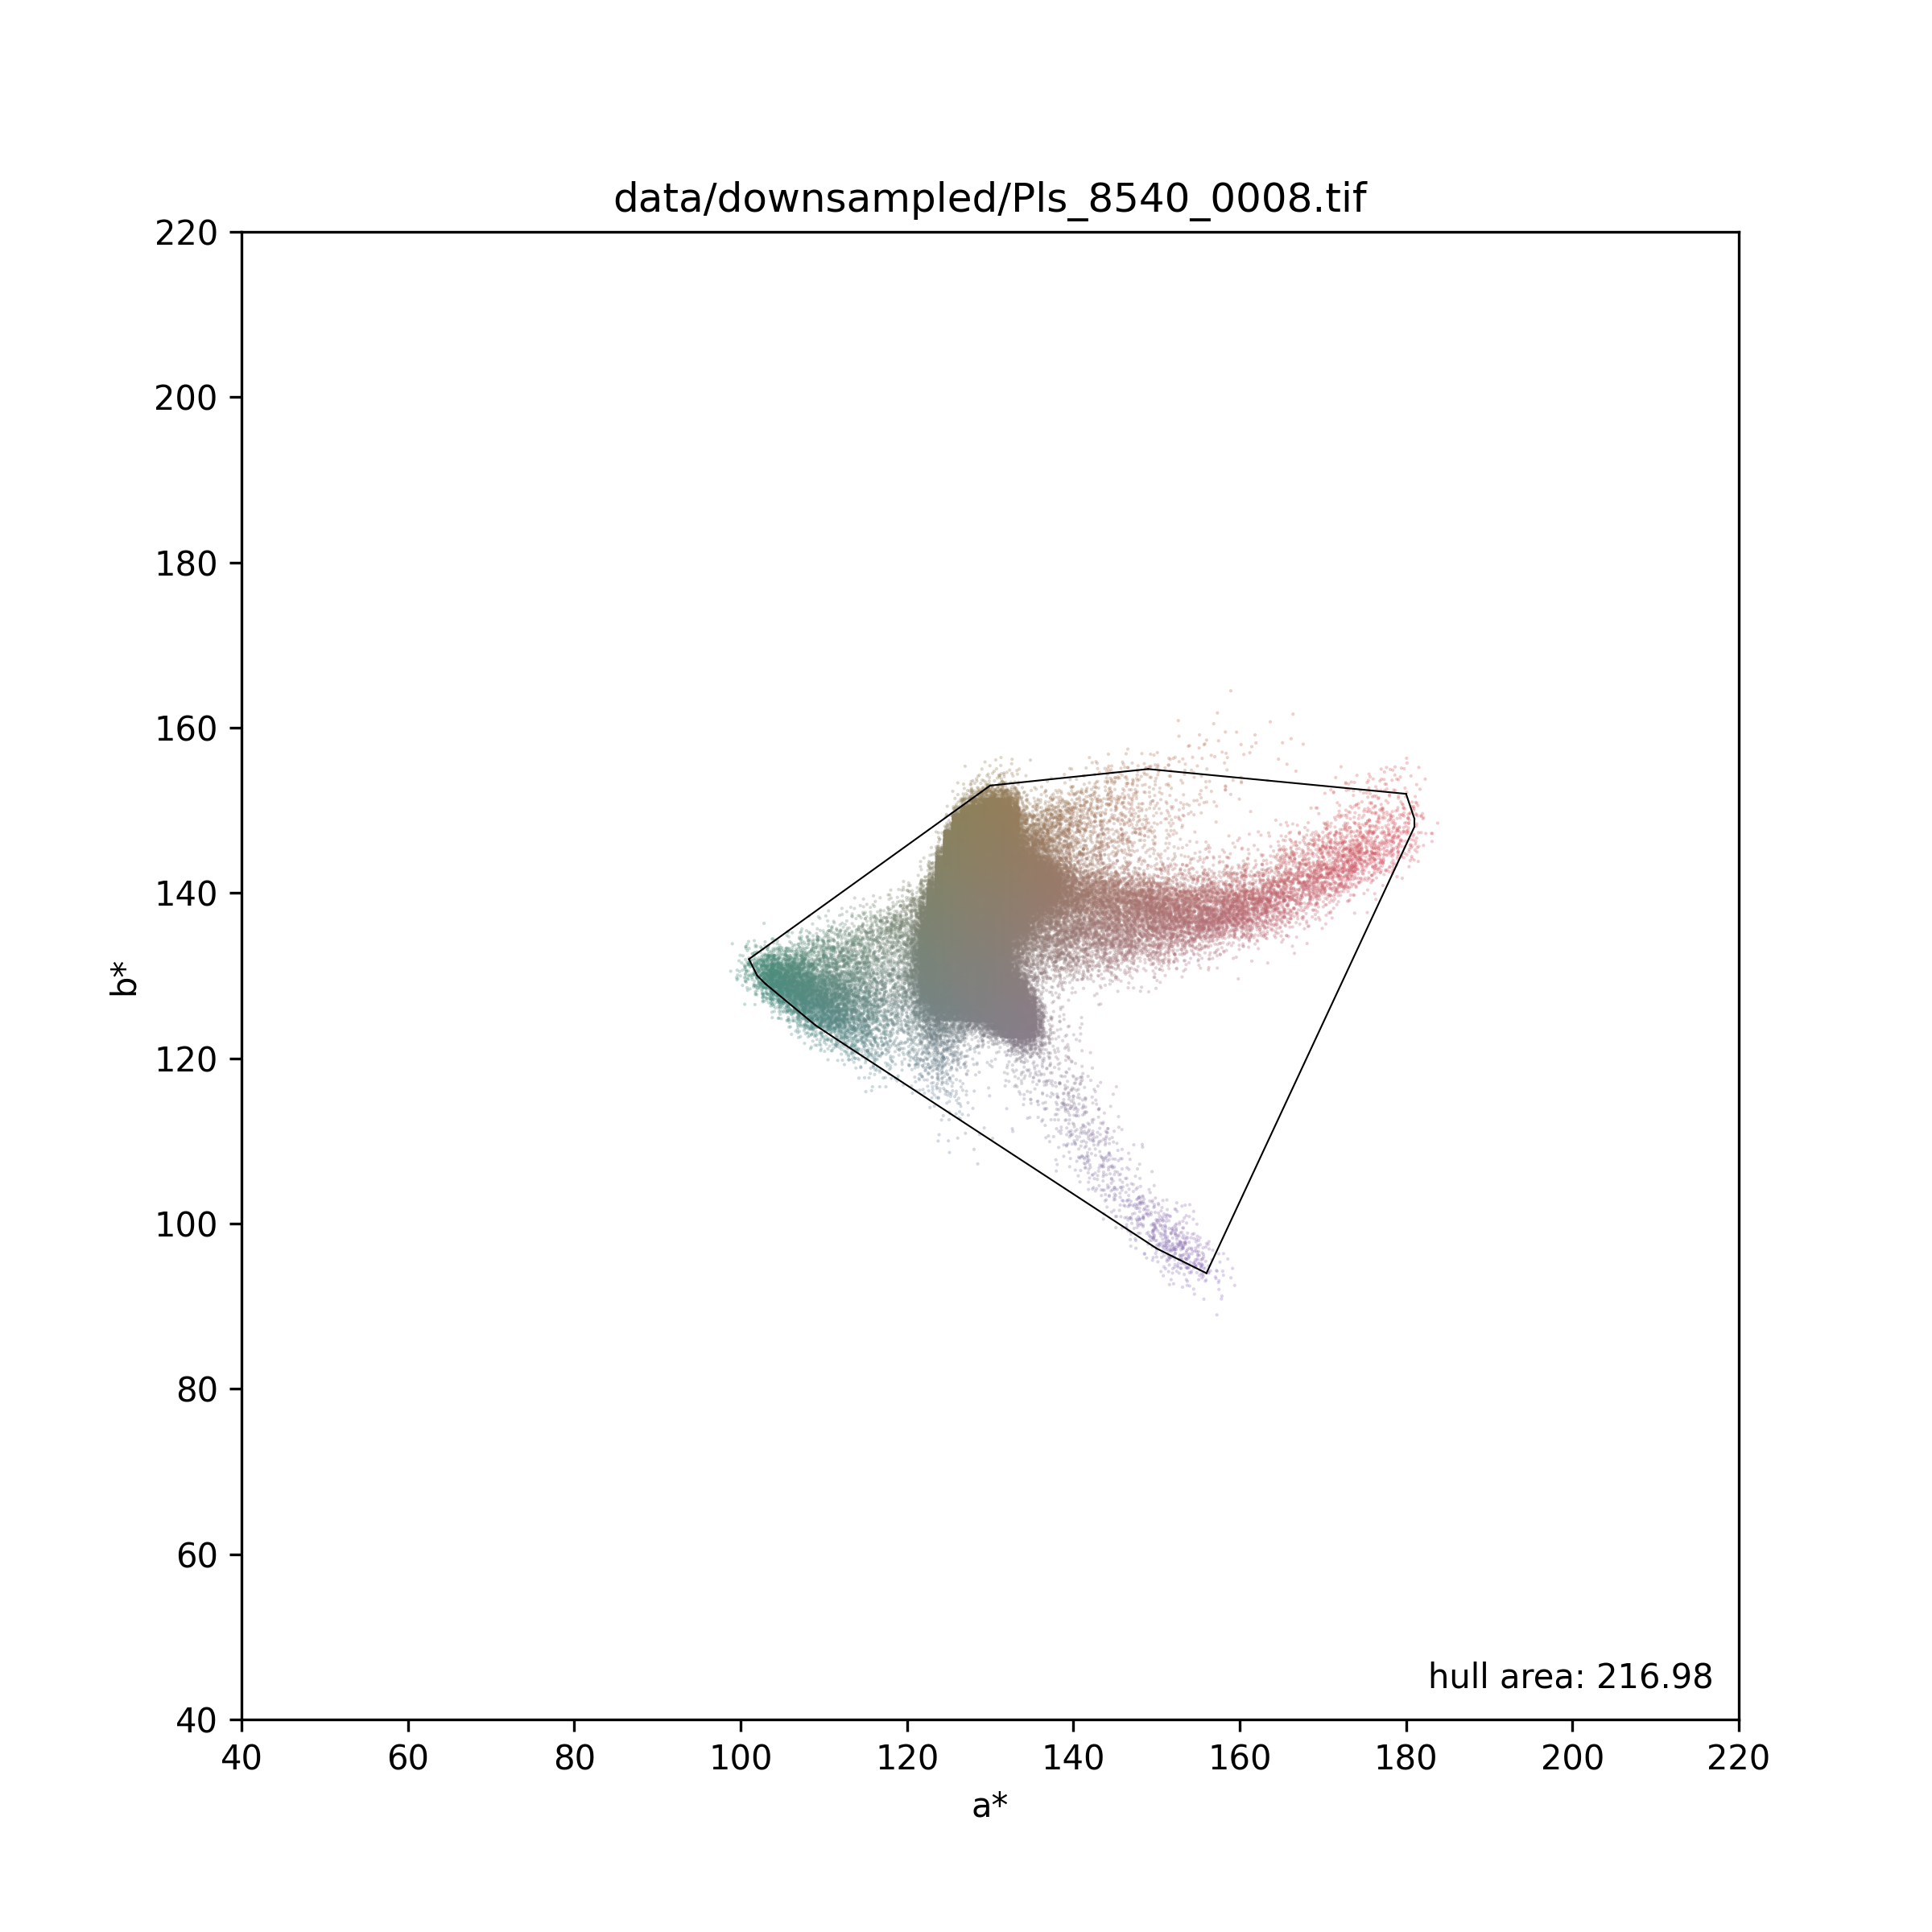

Slide 8
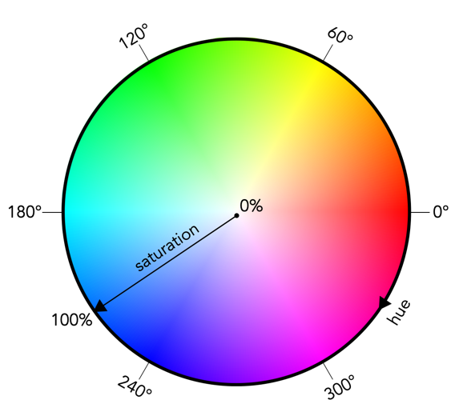
Results
Hull-Thresh 125:
true true: 35
false false: 16
true false: 9
false true: 0
Results
Hull-Thresh 100:
true true: 41
false false: 16
true false: 3
false true: 0
Results
Hull-Thresh 85:
true true: 43
false false: 15
true false: 1
false true: 1
Duration: ~6 min for the 60 maps with scale-factor of 0.25,
~70 min with scale-factor of 1
This would also
work in HSV
Results are available at: https://github.com/rue-a/image_color_analysis
CLI usage:
python get_color_hull.py data/original/<img_name>.tif
python plot_color_hull.py data/original/<img_name>.tif --scale-factor 0.2 --jitter 0 --point-size 4 --draw-hull false –O <out-name>.png

Slide 9
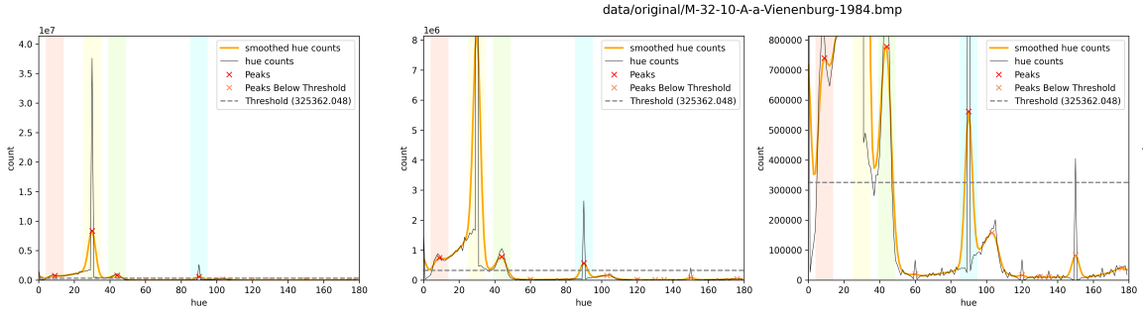
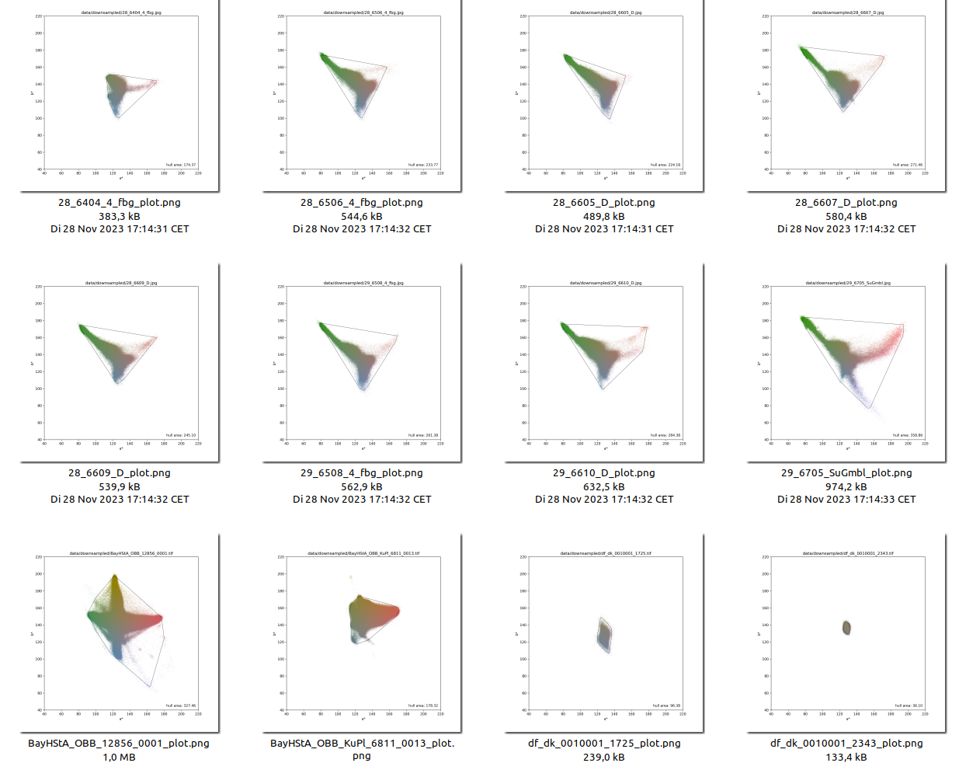
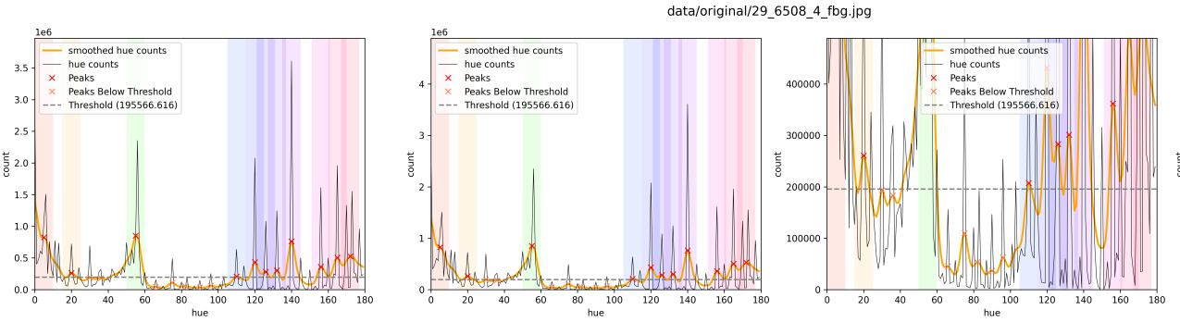
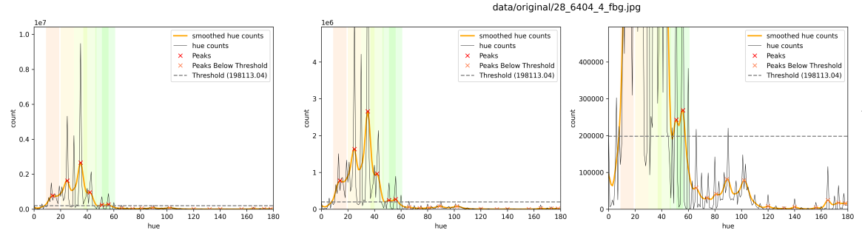
THE END

